Slide 1
Grants Training for Presidents Elect
And for Foundation Chairs of clubs

Slide 3
August 2022
District Grants
DRFC Geetha Jayaram

Slide 4
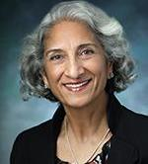
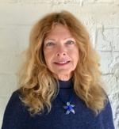
DRFC PDG Geetha Jayaram
Grants Chair Barbara Chamberlain Skinner and Committee

Slide 5
FEATURES OF A DISTRICT GRANT
A single block grant awarded annually for club and district projects
Local or international activities
Local decision making with broader guidelines
Smaller activities and projects
Notes:
District grants are single, annual block grants made to districts in amounts up to 50 percent of their District Designated Fund (DDF).
The district grant can fund multiple club and district projects, which may be local or international.
District grants allow local decision making, with minimal restrictions, for smaller-scale activities and projects.

Slide 6
Step
Decide on your goals and $ amount

Slide 7
Step
What is your area of focus?

Slide 8
Prepare some background for why you chose
the topic for a Grant
What do you see in your community?
What effects does the issue have in your area?
Why do you want to help?

Slide 9
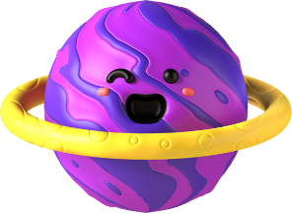
Increase impact
Extend reach by joining hands and contributions
Million dollar dinner and giving to the Foundation
Rotaract can apply and join every major committee
Disaster response RI grants without match

Slide 10
Join hands to scale up, expand reach, magnify scope and visibility for ESRAG, for Disease Prevention, Water and Sanitation and much more!! Partner with others in the community who are leaders with experience

Slide 11
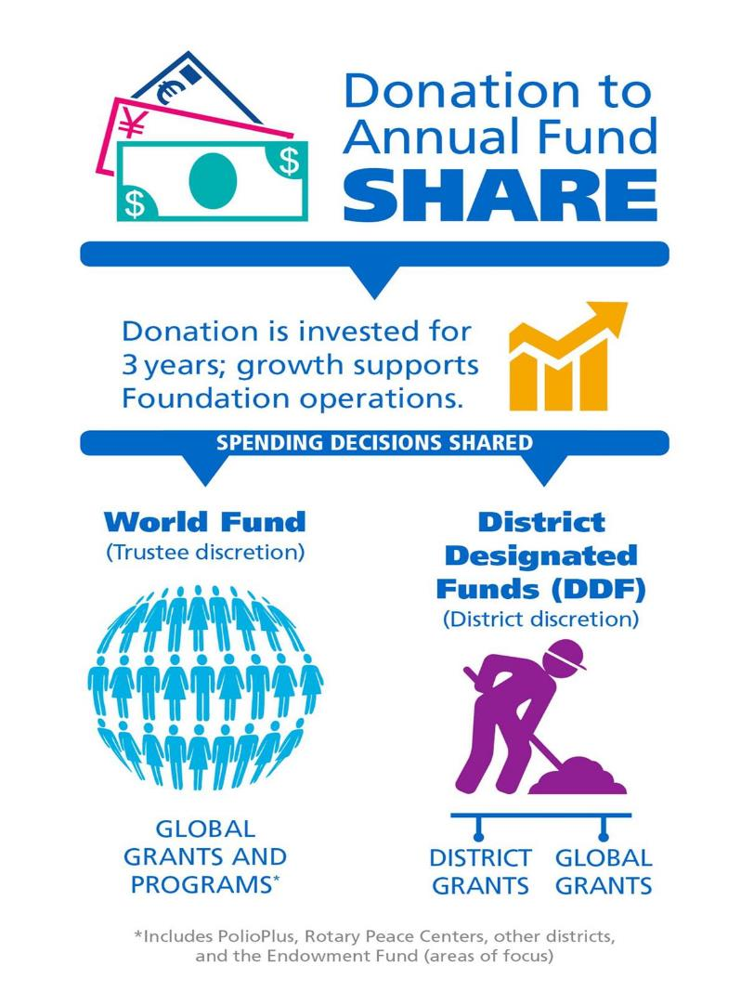
Annual fund share

Slide 12
Step
Prepare your plans NOW to work with your Area clubs to expand your reach on a topic of your choice; use the District Funds well and fully; consult the Grants Committee at planning stage

Slide 13
Present your ideas to others
Review the Rotary Innovations by our youth
Include Rotaractors and Interactors in your plans

Slide 14
NEEDS ASSESMENT IN YOUR COMMUNITY
SCOPE OF THE PROBLEM
COMMUNITY STAKE HOLDERS
DATA GATHERING

Slide 15
WHO IS LOOKING TO PARTNER FROM YOUR DISTRICT, OTHER DISTRICTS, AND ACROSS THE GLOBE?

Slide 16
1
2
3
Get your team together
Write your topic
or idea or Area of Focus
Who will do what and when; for whom and how many; how will you measure it?

Slide 17
What is an MOU?
How many Every Rotarian Every Year Contributions?
How many Paul Harris Fellows do you have?
Check your club Banner report for the year
How is your per capita giving?
Instructions are on Dacdb and District webpage under Foundation
You need to have $120 per capita for the year.

Slide 18
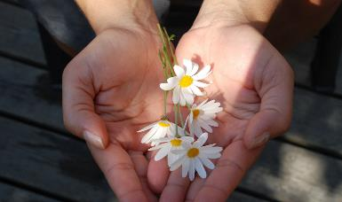
Banner Report
Per capita giving of $120

Slide 19
$120 per capita giving to the Annual Fund, Polio, or District and Global Grants

Slide 20
Paul Harris Fellows in your club 50%

Slide 21
Every Rotarian Every Year 50%
$25 per year

Slide 22
Who must attend the MOU training?

Slide 23
The 2022-23 Club President and Club Foundation Chair must attend grant management and qualification training arranged by the District Chair (DRFC)
If a club President is unable to attend training due to extenuating circumstances, the President Elect may attend in his or her place

Slide 24
Clubs that do not meet the MOU requirements are strongly encouraged to participate with those that have executed an MOU
What if you do not meet the MOU criteria?

Slide 25
The goal is to have every club in the District learn how to apply for grants and to work toward MOU certification

Slide 26
Newly formed clubs are exempt from the MOU requirement for a period of 2 years
They may apply for a small grant of $1000
Rotaractors have the same exception
Exceptions
(determined by the DRFC and Grants Chair)

Slide 27
Matching
Your contribution is matched $1: $1
1
2
Max for any club is $5000
3
Max for a single grant is $13500
All actions based on funds and annual grants awarded to District

Slide 28
Additional points for Community Grants
Window for application is March 1st to May 31st of the year
Application via the Dacdb grants module only
If needed a second round of grant applications will be solicited
Our goal is to use all DDF funds for our communities

Slide 29
Other points for Community Grants
Check with the Grants committee Chair before you begin for assistance
Clubs with approved grant applications will get 50% of their grant funds first before the project begins

Slide 30
REPORTS
At the conclusion of your report
The remaining 50% will be paid upon the completion of the grant reporting requirements

Slide 31
All funds must be expended and a compliant Final Report, including detailed explanation of expenditures, must be submitted in DACdb by May 15, 2023

Slide 32
Club Banner report
Scroll down to Contributions and Recognition
Click on club giving and view reports
Open club foundation banner report for correct year
Drag the cursor to the left
Click on
Foundation reports
Go to MyRotary
Click on the Foundation tab

Slide 33
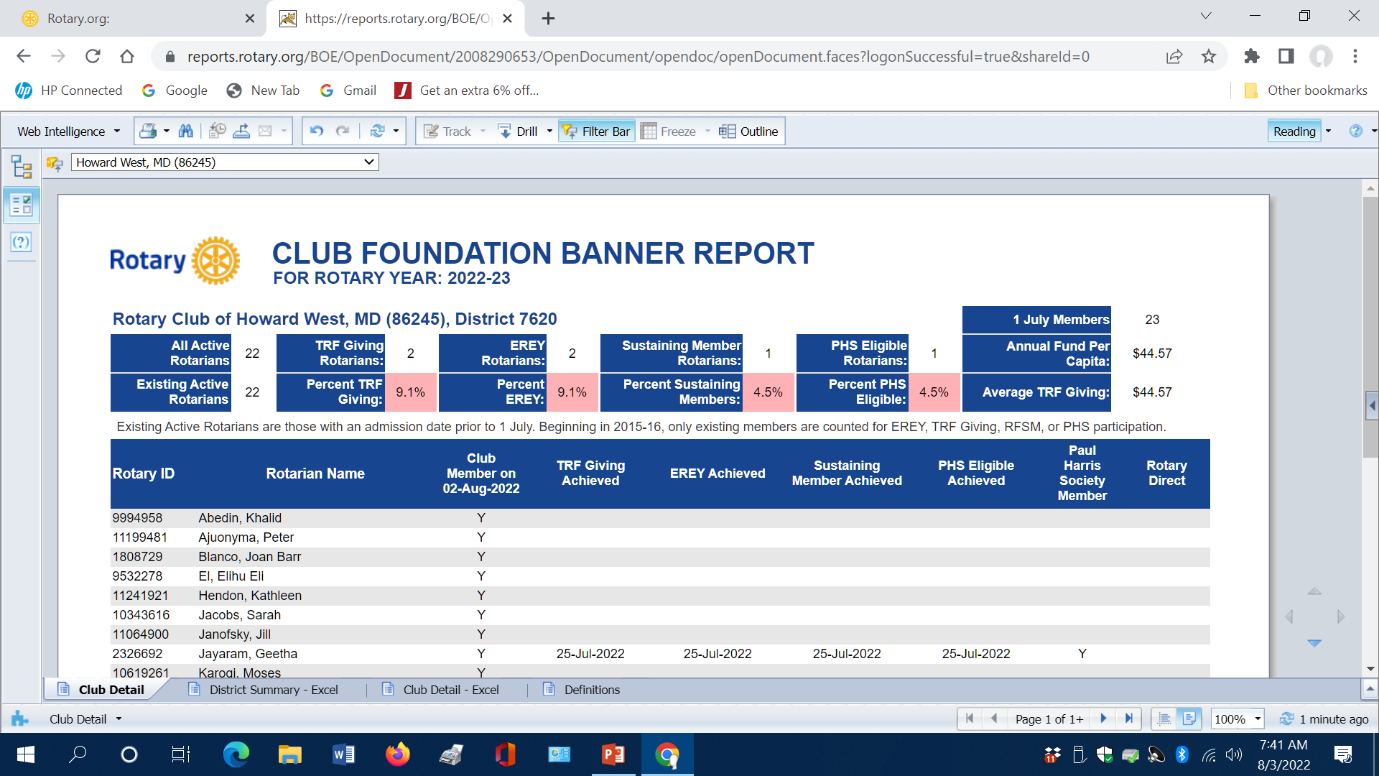
Banner report sample

Slide 34
August 2022
Global Grants
DRFC Geetha Jayaram

Slide 35
Global Grants guidelines
Beginning annually July 1

Slide 36
FEATURES OF A GLOBAL GRANT
Align with an area of focus
Respond to a community need
Must have a host club in the country of the project and an international club
Strengthen knowledge, skills, resources
Have long-term, sustainable benefits
Produce measurable results
Online application through TRF
Minimum budget of at least $30,000
DDF allocation is matched 80%
Notes:
The minimum grant award is $15,000 (for a total budget of at least $30,000). The DDF allocation is matched 100 percent, and cash is matched at 50 percent from the World Fund. A global grant project is sponsored by a host club in the project country and a club outside the project country.

Slide 37
Notes:
Go to page 6 of the Global Grants guide for information on steps for monitoring and evaluation

Slide 38
Global Grants
Are reviewed by Rotary International Staff
There are individual representatives based on the geographic location of the grant application
The application steps are contained within the grant format
You can write to the staff person in the required area if you have concerns

Slide 39
Global Grants
Make sure the receiving District is in good standing
Do not click submit until all your data is in
Unlocking an application will take time and requires RI staff to do so
Get the international partner to sort out their commitments and roles clearly before beginning
application

Slide 40
A single club may not exceed a request of 15% of total DDF money
All decisions subject to DRFC review

Slide 41
Funding of the approved DDF and Final Report requirements will be in accordance with the Terms and Conditions for Rotary Foundation Global Grants
Changes may occur during the year based on review

Slide 42
Try again the next year if funds have run out or your efforts need modification
Call the Grants Chair BJ Chamberlain or DRFC Geetha Jayaram for information or assistance

Slide 43
Questions?
.
Club wide
Area wide
District wide
Multi District wide
Global

