Slide 1
District
Community Grants
Notes:
As Geetha indicated, there are 2 types of grants that use District Designated Funds for matching Rotary Club contributions.
The first is ”Community” grants that are small, short-term humanitarian projects. and can fund:
local, District or international service efforts
vocational training
community assessments
construction and renovation
RI prefers active involvement in the grant and Rotary signage (up to $1,000)
DDF can not fund:
a particular political or religious viewpoint or function
fundraising activities
purchase of land or buildings
Rotary events
unrestricted donations to a beneficiary or cooperating organization – all grant money must be used for specific project expenses
As Geetha has stated, community DDF
matching is limited to $5,000 per participating Club
a max per grant of 15% of available DDF, around $13,500 this year
MUST be completed between 1 July and 15 May

Slide 2
Application period is 1 March through 31 May
Must be submitted via DACdb Grants Module and
Must align with:
Rotary’s Focus Areas
Terms and Conditions for District Grants
Our District 7620 Grant Guidelines
The 4 Way Test
Notes:
If funds are still available after the first round of approved matching grants, clubs may submit additional grant applications pursuant to announcements by the DRFC
There are extensive training materials available in DACdb and in the Learning Center regarding the mechanics of imputing the application, including videos
The Terms and Conditions and details of the Focus Areas can be found in MyRotary
District Guidelines are on the District website (and will be discussed in the following slides)
As time permits, the Grants Committee will provide feedback on draft or submitted applications
The earlier the application is submitted, the more likely we can provide feedback

Slide 3
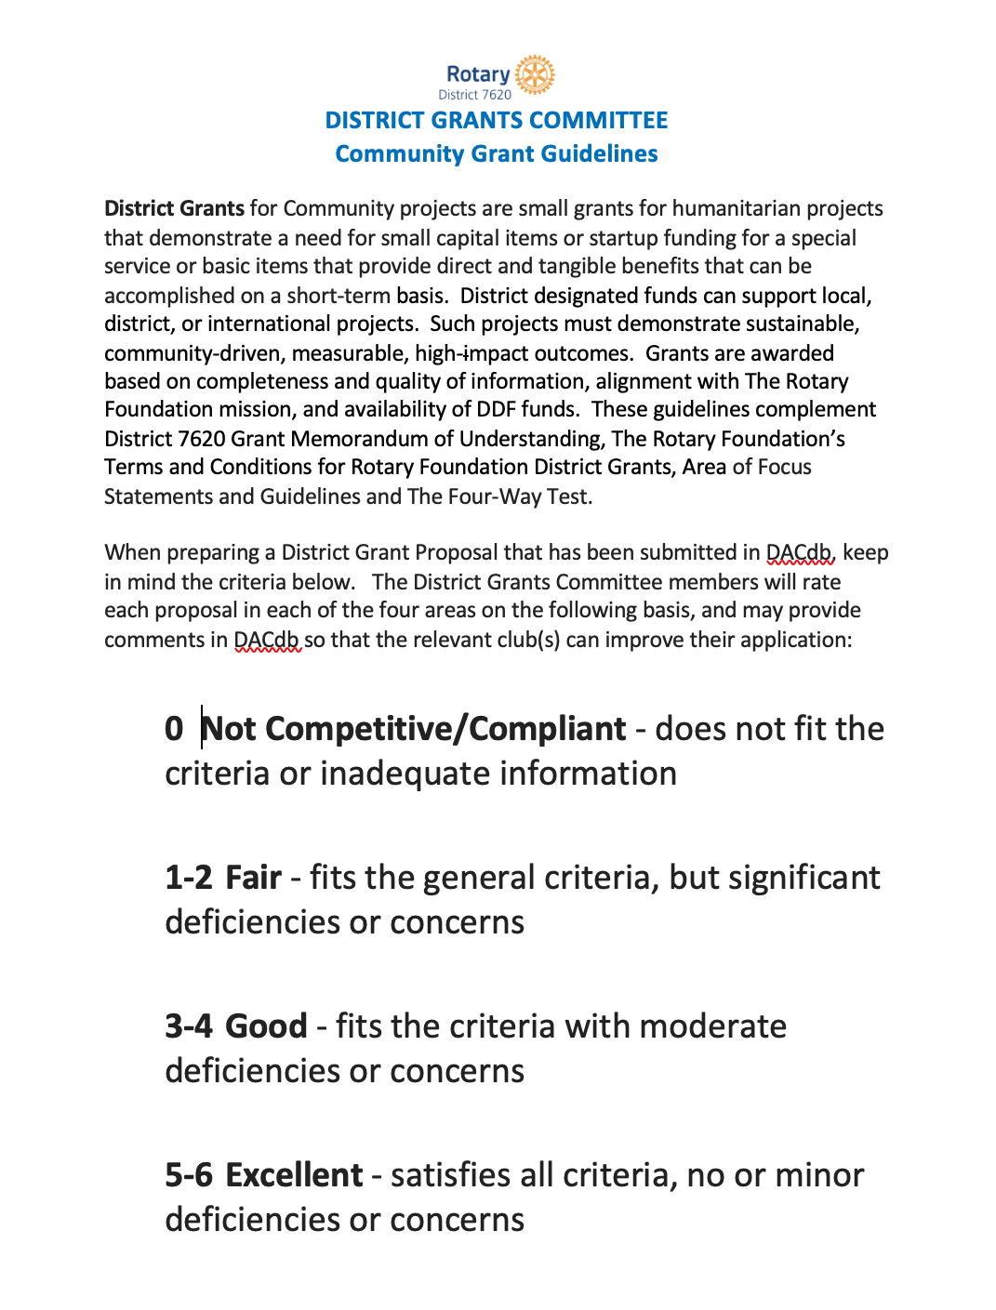
DISTRICT 7620
Grant guidelines
Notes:
Geetha as the DRFC established a Grants Committee comprised of 6 Rotarians from various clubs around the district (large and small, city to county) who:
advise on grant development
review applications
score application based on Guidelines
scoring each application on 4 major criteria
on a scale of 0 to 6
the Committee then meets to reach a consensus recommend awards of DDF
The Grants Committee focuses on community grants but can advise on global grants.
Our Grant Guidelines generally apply to both community and global grants
Note that we often get more applications than available matching funds
competitive award
not first come first funded

Slide 4
PROJECT OBJECTIVES
Community needs
Alignment with The Rotary Foundation’s mission and Areas of Focus and District priorities
Describes the specific project goals
Notes:
So what is the Grant Committee looking for?
Clear statements of the need for the project – supported by community input
where did the idea originate
who were involved in the concept /project development
not formal Community Assessment as required for Global Grants but due consideration of community and beneficiary input
not starting with or dictating a “solution looking for a problem”
Identification of the Focus Areas and relation to District priorities
no longer benches
this year the emphasis is on Maternal and Child Health and Economic Development; Dee may have another emphasis
Must clearly describe how the project goals and how they address the community need
the easier you make it to understand the applications intent and benefit, the easier the Committee can score the application higher
including support for attaining the objectives - e.g., past experience by a Member or the Club or organization

Slide 5
DESIGN AND MANAGEMENT
Work Plan
Timeline
Partners
Roles and Responsibilities
Notes:
The attachments to your application should include a detailed work plan identifying
Project tasks
Task assignments – by organization; whose doing what
Milestones
Key deliverables
Required resources
RI strongly urges local ownership, local training, buying locally and some local contribution. This should be built into your work plan.
Projects may not commence until notification of award – 1 July at the earliest; they can not be in process per RI
And must end (all activities completed and funds spent) by 15 May
The application must identity all participants that are needed for the successful implementation of the project, including other Rotary Clubs, non-profit entities and beneficiary organizations
As Geetha said, we encourage clubs to work together and encourage partnerships with reputable community organizations.
The Committee performs a quick check on outside participating organizations (e.g., Charity Navigator)
for international projects, must have a local Rotary Club involved to manage and report on the project
must include letters of participation from all participating organizations and international Rotary Clubs acknowledging their roles and responsibilities
e.g., if planting a butterfly garden on school property, must include a letter of permission by the school

Slide 6
Metrics to evaluate the success
Concrete changes
Benefits a significant number of people or has a significant impact
Details the plans and responsibilities to sustain the work
IMPACT AND SUSTAINABILITY
Notes:
The application should delineate specific outcomes with supporting data to verity the outcome
precise metrics
evidence based
e.g., 6 wells dug, 10 solar panels installed, 80 students certified by the technical college
The Committee does look at the breath of impact –
the more beneficiaries the higher the score, though this is not dispositive
include secondary beneficiaries – e.g., 10 teachers trained who will teach 300 female students over the next year
Sustainability is a big deal and can make or break the application
Sustainability is defined b Rotary as a project that “provides long-term solutions for community problems that community members themselves can support after the grant funding ends.”
This reinforces the requirement to start with the community need and involvement.
The application should include commitments from the participants for the specific actions needed to maintain the project
The District will not fund a project year after year - though will support follow-on or differing beneficiary-pool projects

Slide 7
FINANCIAL FEASIBILITY
Line-item detail of the program budget
Line-item detail of committed funding sources
Notes:
Budget should be supported by quotes
included as attachments to the application
e.g., a vendor quote for 5 desks at $200 each
should be competitive – list or include 3 sources or why not
Funding sources include other Rotary Club and outside contributions – though only qualified Club contributions are matched
The budget must match the funding
The application should demonstrate that the costs are reasonable in relation to the outcomes
And remember,
the grant can not fund a grant already in process or be a general donation; it must be used for a specific project
50% of DDF is awarded by the District upon notice of award/after the District receives their share from RI (usually mid-July) so the Clubs and organizations need to work out any upfront financing

Slide 8
Describe the implemented project and each organizations’ role
Detail metrics and data collection
Discuss sustainability
Include a detailed account of project spending
Final Reports
Notes:
Final Reports must be submitted in DACdb
To meet RI’s timeline for the District reporting to RI, our Clubs must submit their report to the District by 15 May
RI’s Terms and Conditions require reports to contain detailed account of the project’s actual implementation
Describe how the project met the objectives in the application
Include a description of how any host and international partners, as well as any cooperating organizations associated with the grant, participated in the project
Detail the metrics used to measure success – provide the data as an attachment
Include invoices demonstrating the proposed budget items were purchased
District 7620 really wants all grants to be successful and understands that there may have been delays and adjustments
include a brief explanation of any deviations
The Grants Committee will accept reasonably related deviations to the approved scope and proposed expenditures if they are consistent with the original purpose of the grant
Upon review and approval of the report by the Grants Committee, the remaining 50% of awarded DDF funds will be released
Don’t have to wait til May to submit
Earlier submit, earlier can get the balance
Also allows time for correction/augmentation
If Final Reports are not submitted and approved, all DDF received for the grant will have to be returned to the District

Slide 9
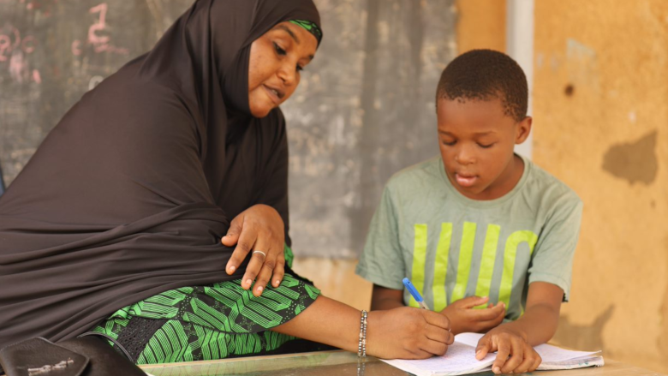
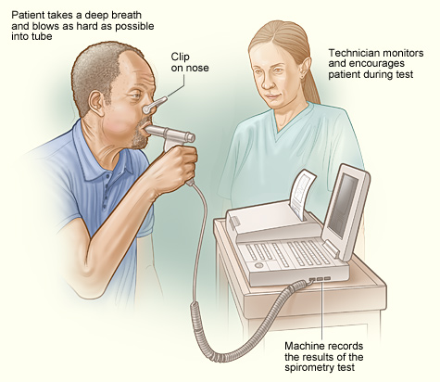
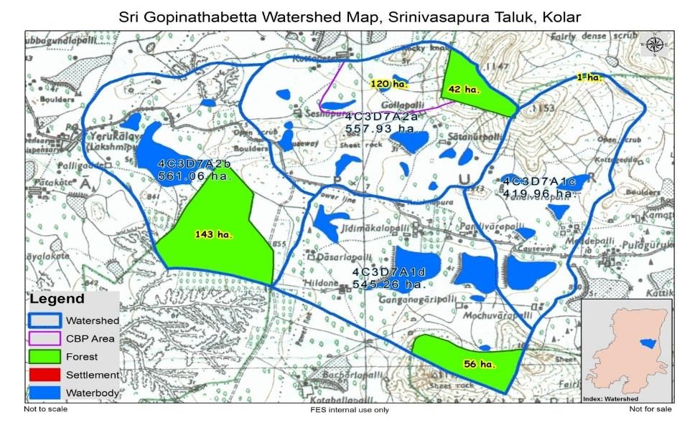
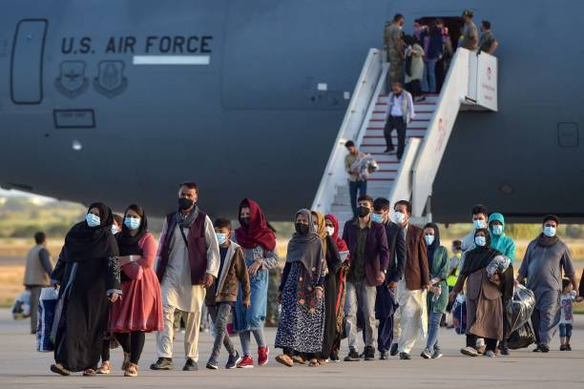
Notes:
Backpacks for Bright Futures – working with Untied Way, the Rotary Club of Carroll Creek will provide needed backpacks and school supplies to K-12 students in any of the 27 FCPS schools located in Frederick City for the 2022/2023 school year. Rotary Club of Carroll Creek will provide volunteers, event organization, and backpacks.
Gopinathabetta Watershed Project involves renovating small cattle ponds and recharge structures for public bore wells, incentivizing more sustainable agricultural practices, improving fencing to prevent livestock from denuding the landscape, supporting home gardens, demonstrating alternative livelihoods, and undertaking a range of knowledge management activities to encourage improved agricultural, water and natural resources management. It is a 3-year project; this is the second year we are funding it with the understanding that it is for different villages in India. Capital Hill and College Park RCs are working with a reputable NGO, Foundation for Ecological Security. {Watershed map drawn by FES]
Mansfield Kaseman Health Clinic Flood Assistance proposed by Rockville and Potomac RCs will support the special recovery and continued operations of the Mansfield Kaseman Health Clinic as it returns to its permanent location following a catastrophic flood on December 25, 2021. The grant will bridge the gap of costs not covered by insurance due to the age of the equipment that needs to be replaced, including podiatry and pulmonary equipment. [spirometer]
To enable Teacher Training in Niger, Africa, Montgomery Village RC has partnered with the Marad Rotary Club, Remember Niger and the Ministry of Education. The project intends to train teachers 80 primary and secondary teaches from 10 different schools (chosen by the schools) to adapt their lesson plans, classroom management and pedagogical skills to meet the standards required by the new Ministry of Education. Remember Niger continually works with the schools to adapt their lesson plans.
Afghanistan Refugee Medical and Mental Health Assistance grant was proposed by 4 rotary clubs to fund Rotarian run volunteer-driven and patient-centered provision of free healthcare for the uninsured and underserved refugees recently arriving in our community. The budget included payment for drivers to bring the refugees to the clinic, basic medical and dental services, laboratory services and translators, and pharmaceutical supplies.
The Rotary Club of Leonardtown requested a matching grant to purchase a commercial grade convection oven for the St. Mary’s Caring Soup Kitchen. Specifically, the funds will be used to finance a Vulcan Model No. VC44GD convection oven to add to the many appliances needed to outfit a new commercial kitchen in a facility recently donated by a local contractor.

Slide 10
Thank you!!

